Slide 1
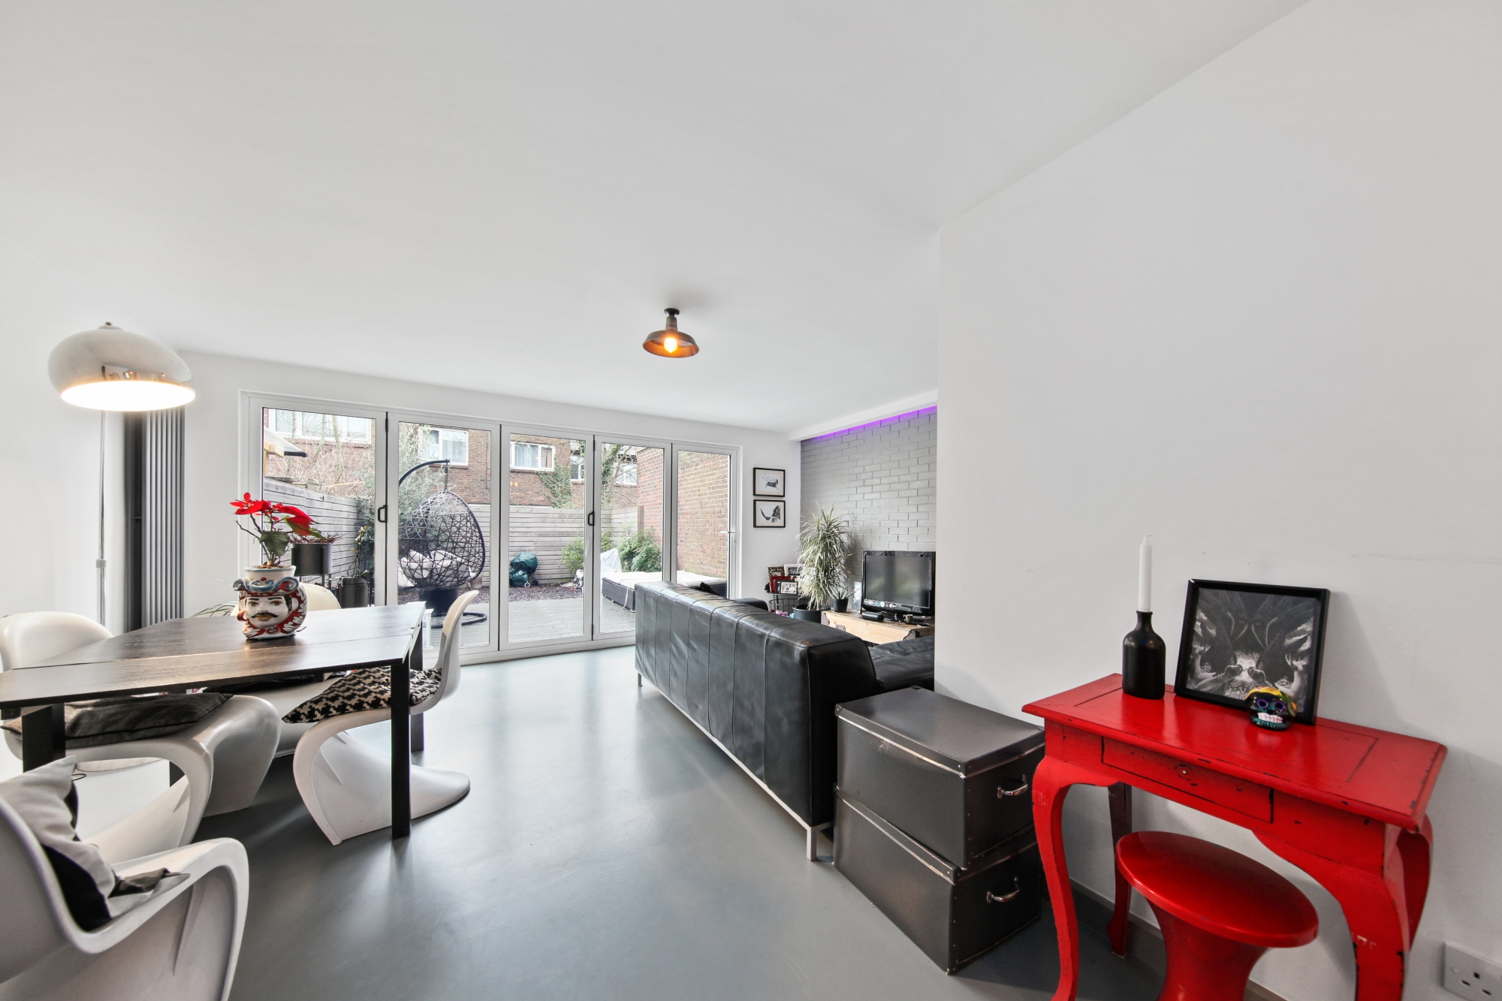
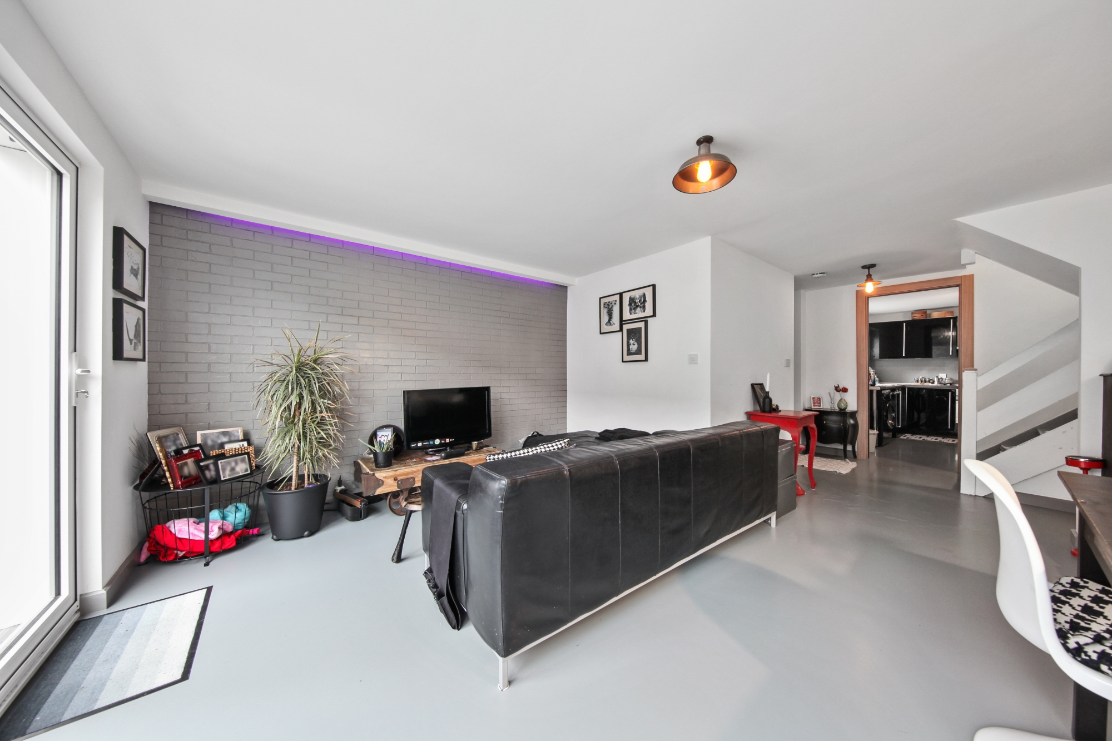
Charlotte Avenue, Fairfield, Hitchin, SG5 4GQ
Woodbridge Close NW2
www.lianaloporto.co.uk
3 double bedroom terraced house for sale (EPC: C)
3 bedroom freehold house
07460 088 110 liana@lianaloporto.co.uk

Slide 2
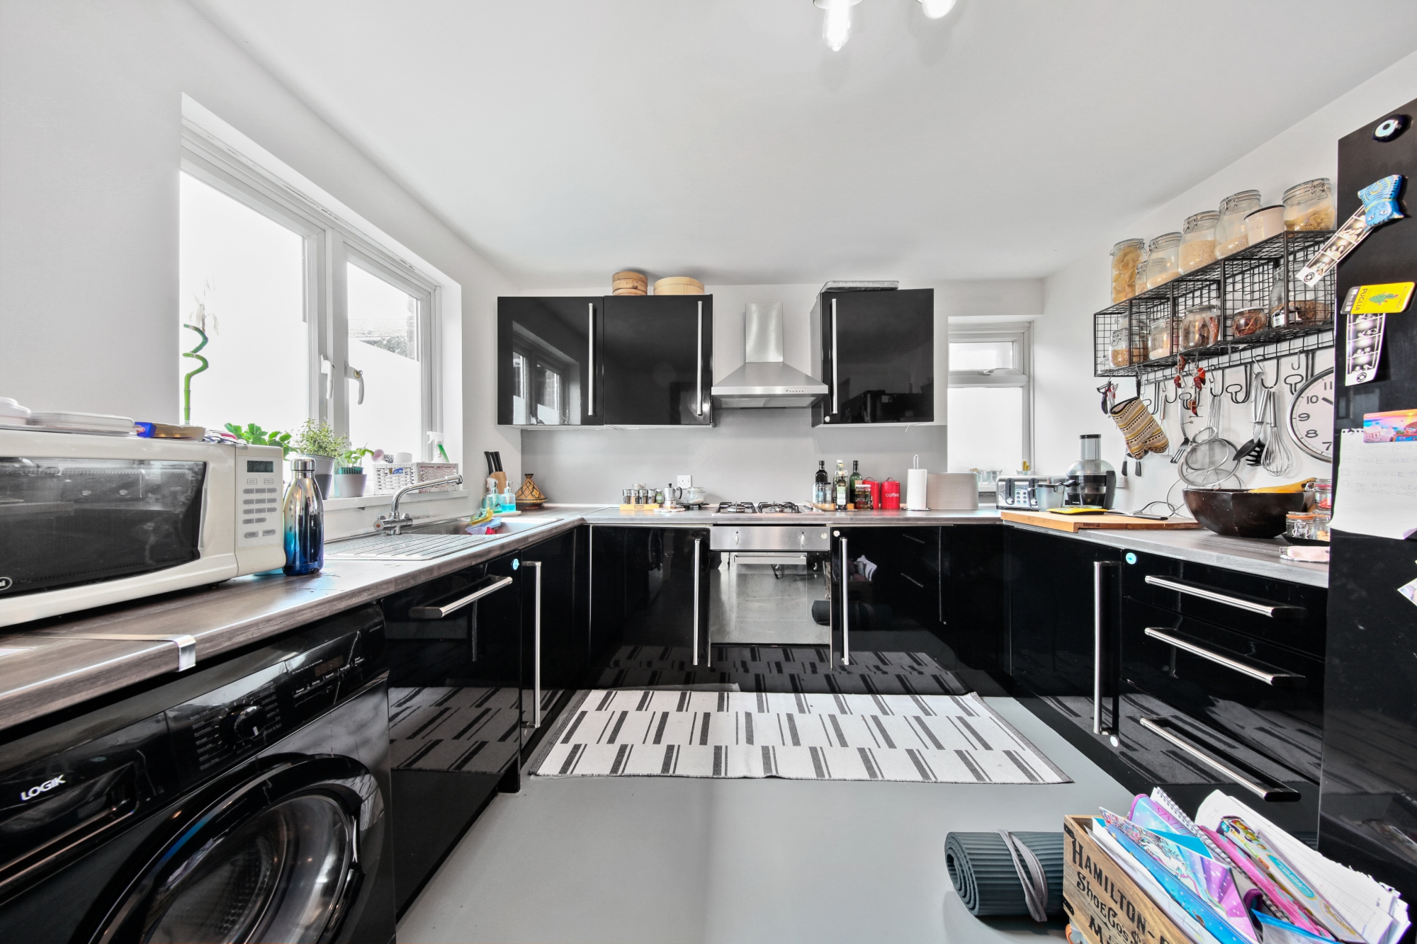
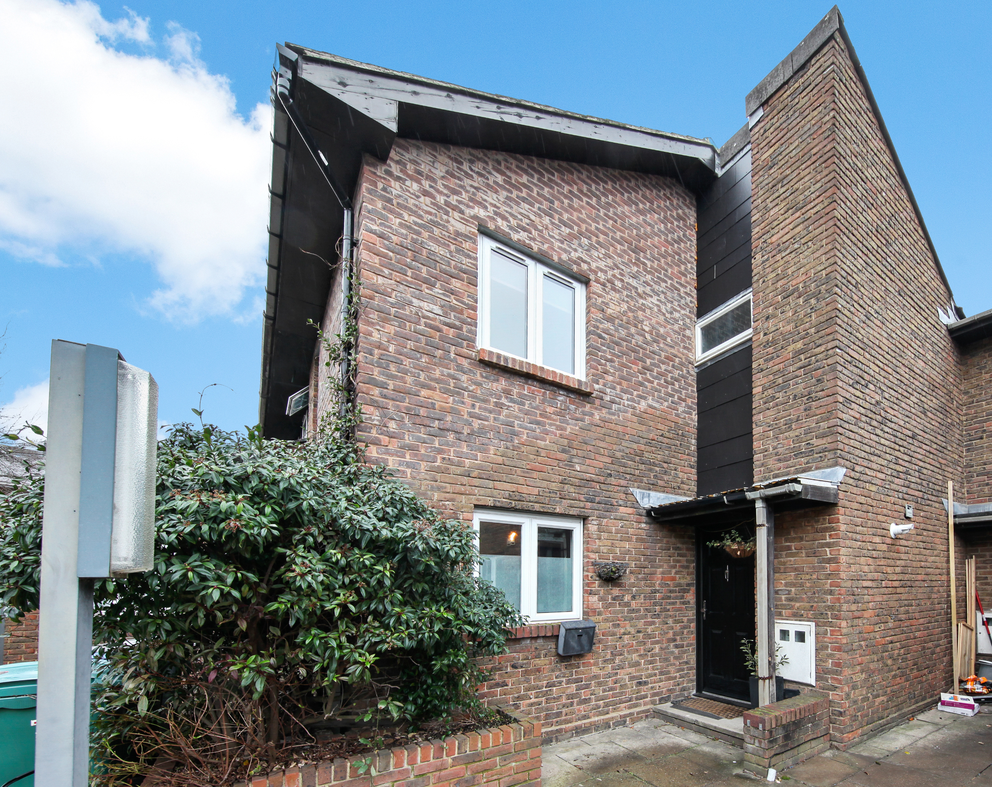
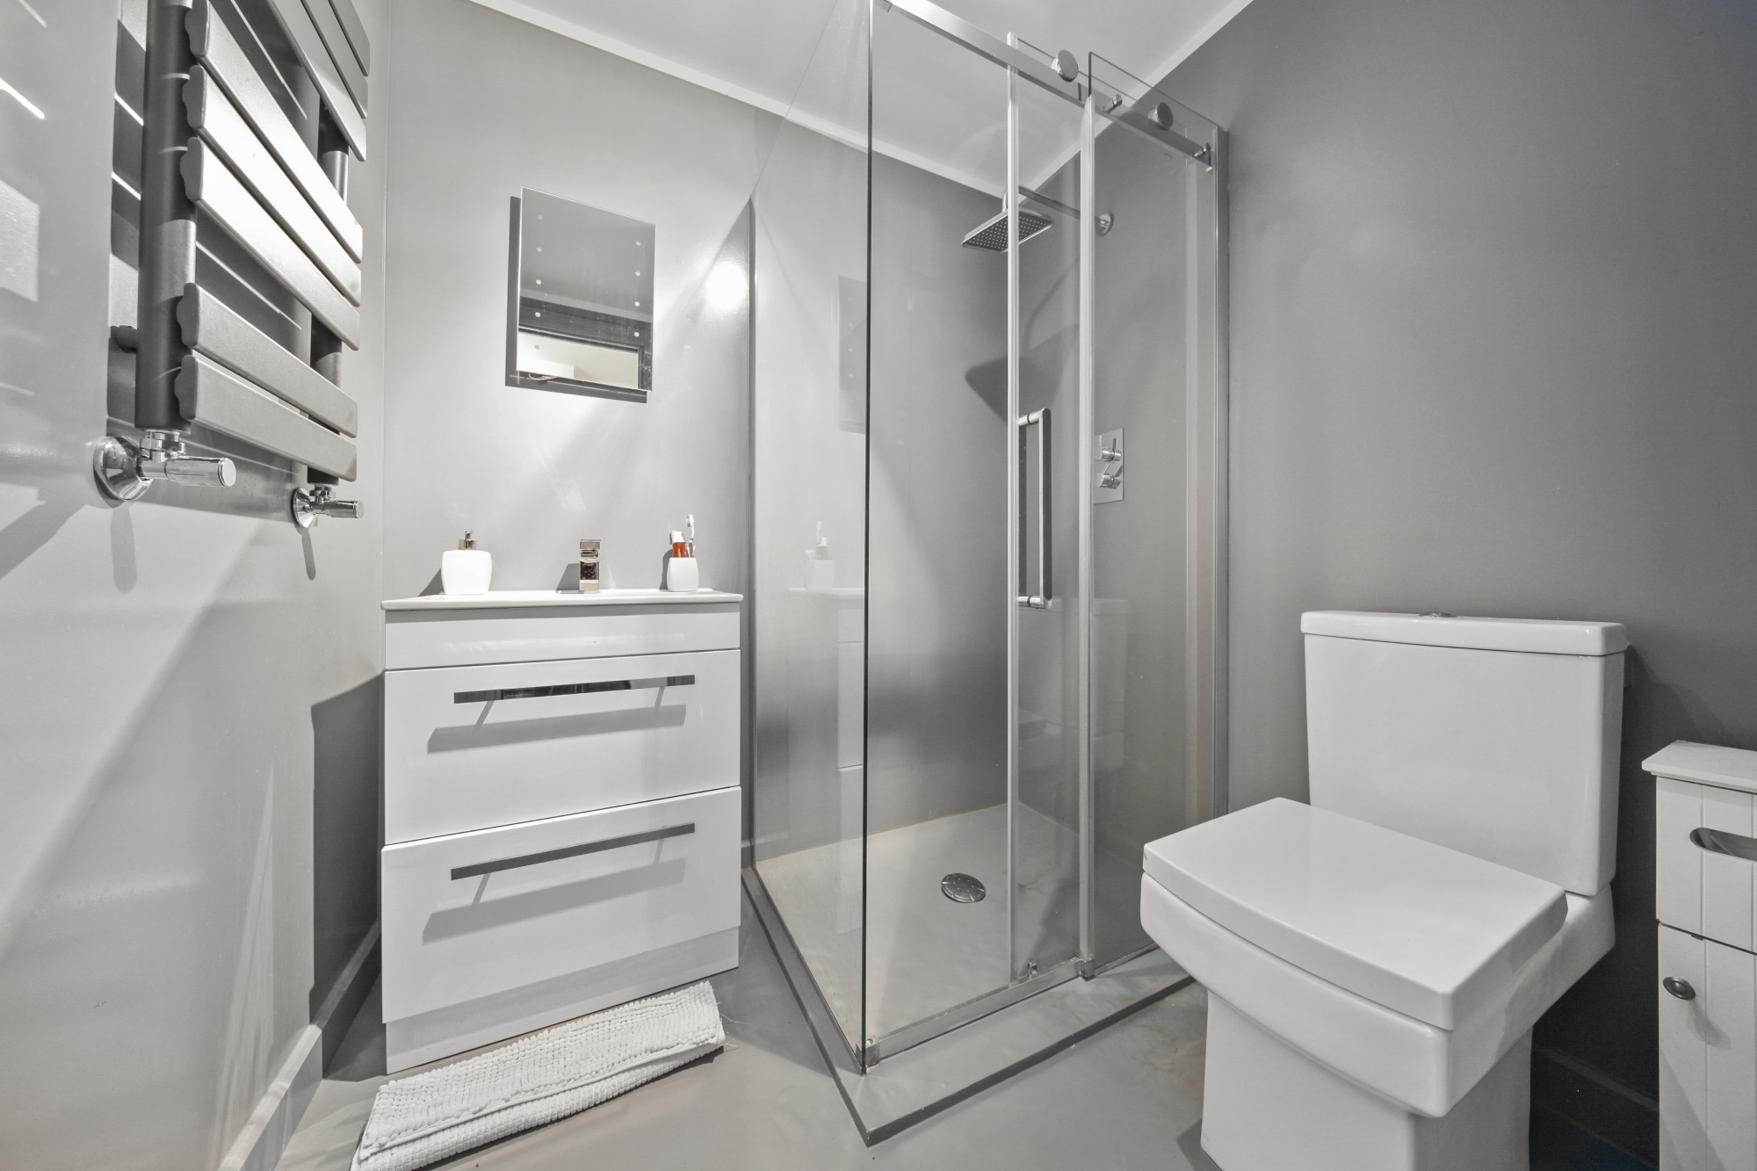
About this property…
3 bedroom Freehold family home located a short stroll away from the wonderful Gladstone Park.
Recently refurbished to a high standard it enjoys a large open plan reception room with dining area, bi-folding doors which lead onto a sunny back garden with BBQ area ideal for entertaining on a hot summers day. There is a modern kitchen with plenty of storage, the owner is a chef so every part of the kitchen has been designed for the pure enjoyment of cooking. The guest WC is modern and neutral and has a rain shower.
Upstairs one finds 3 double bedrooms and a trendy family bathroom.
Woodbridge close is conveniently located within close walking distance from Gladstone Park with the Gladstone Park Café ideal for a pitstop on a weekend walk, there are tennis courts and two lovely playgrounds. There are numerous schools, Our Lady of Grace Junior School and Menorah girls school to name a few. Local shops are a 5 minute walk and Lidl and the famous Wing Yip are a short drive away.
The Brent Cross regeneration is one of the biggest regeneration projects in Europe and London’s most ambitious regeneration project since the start of the pandemic - it will become the capital’s biggest “15 minute town” where shops, offices, restaurants, parks and the train station are all within a quarter of an hour’s walk.
Transport – It is equidistant from Dollis Hill and Neasden Underground stations and within easy reach of Staples Corner, Brent Cross and the M1. Cricklewood Overground is on the Midland Main Line, with regular services to London St Pancras, Wimbledon, Sutton, Luton and St Albans. The station is also served by a number of London bus routes leading all over the city.
www.lianaloporto.co.uk
Trusted, Expert, Advice

Slide 3
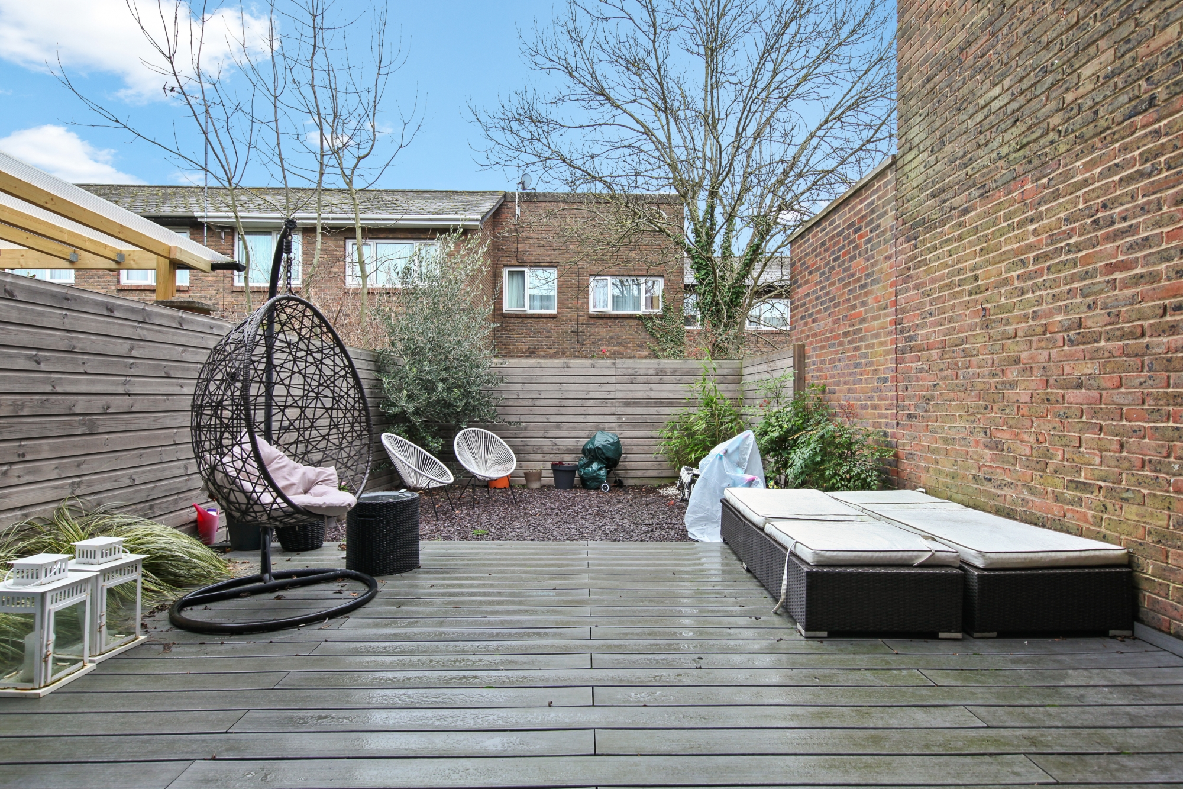
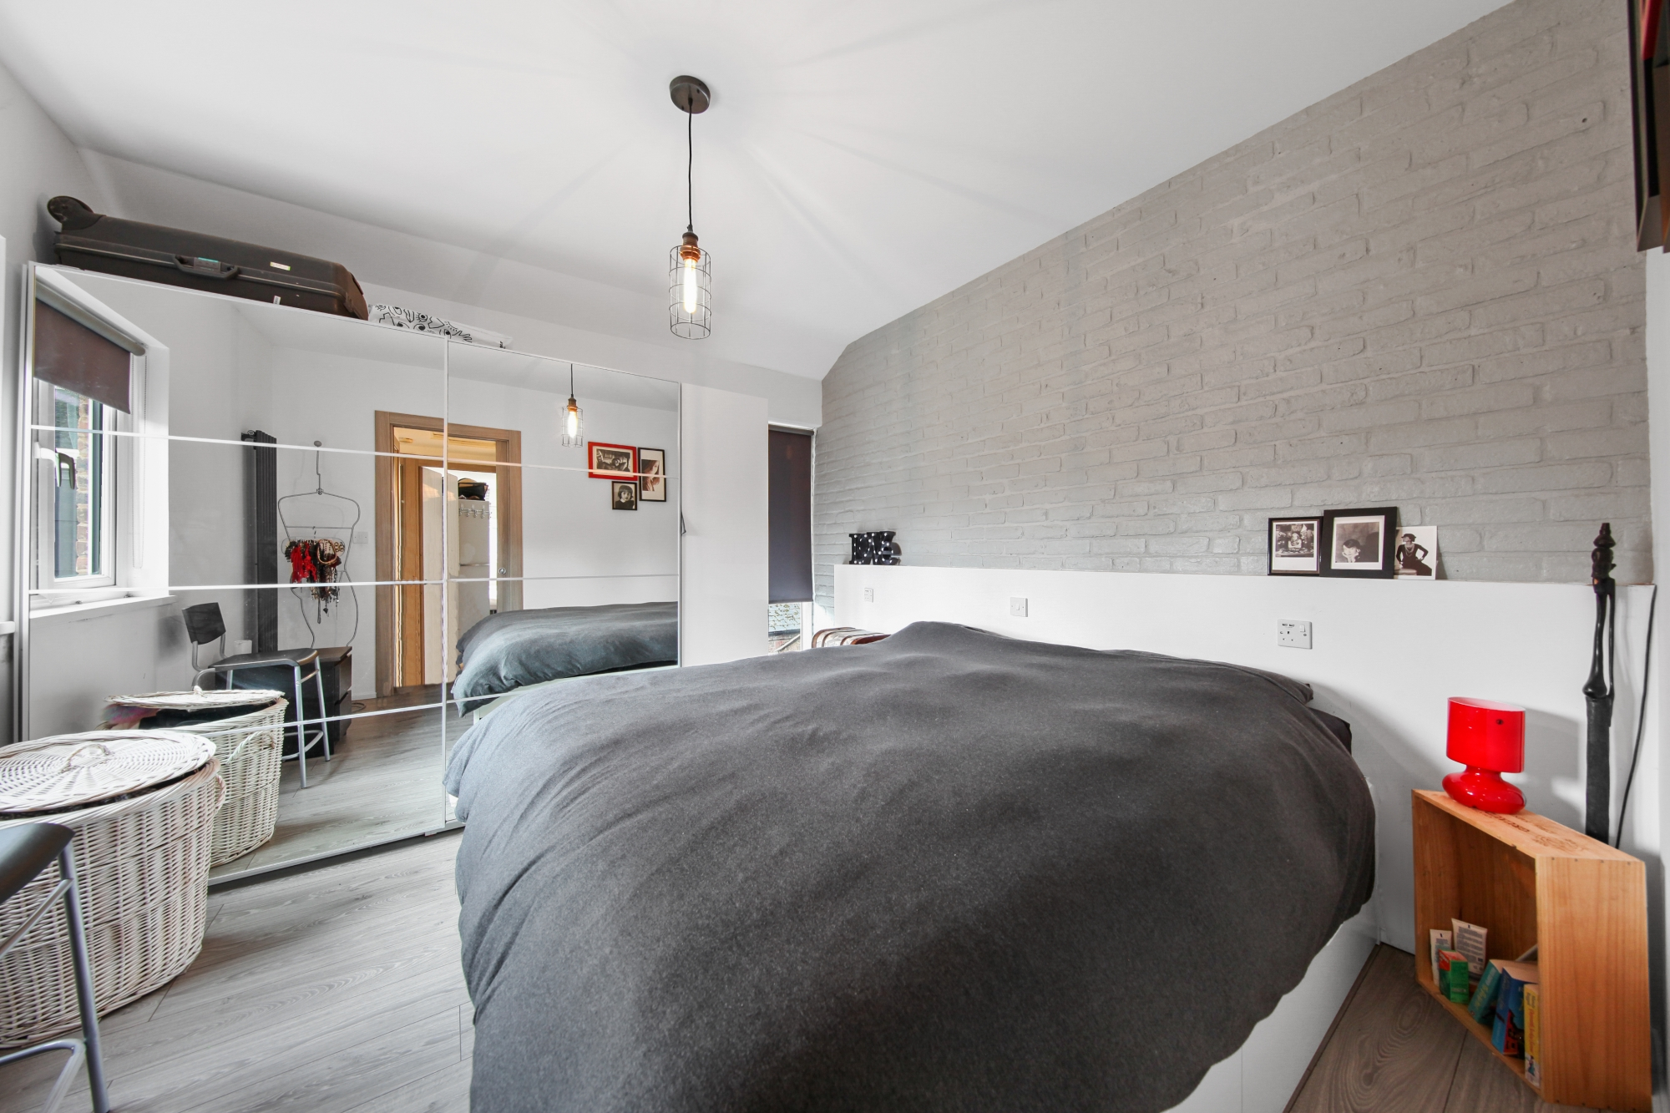
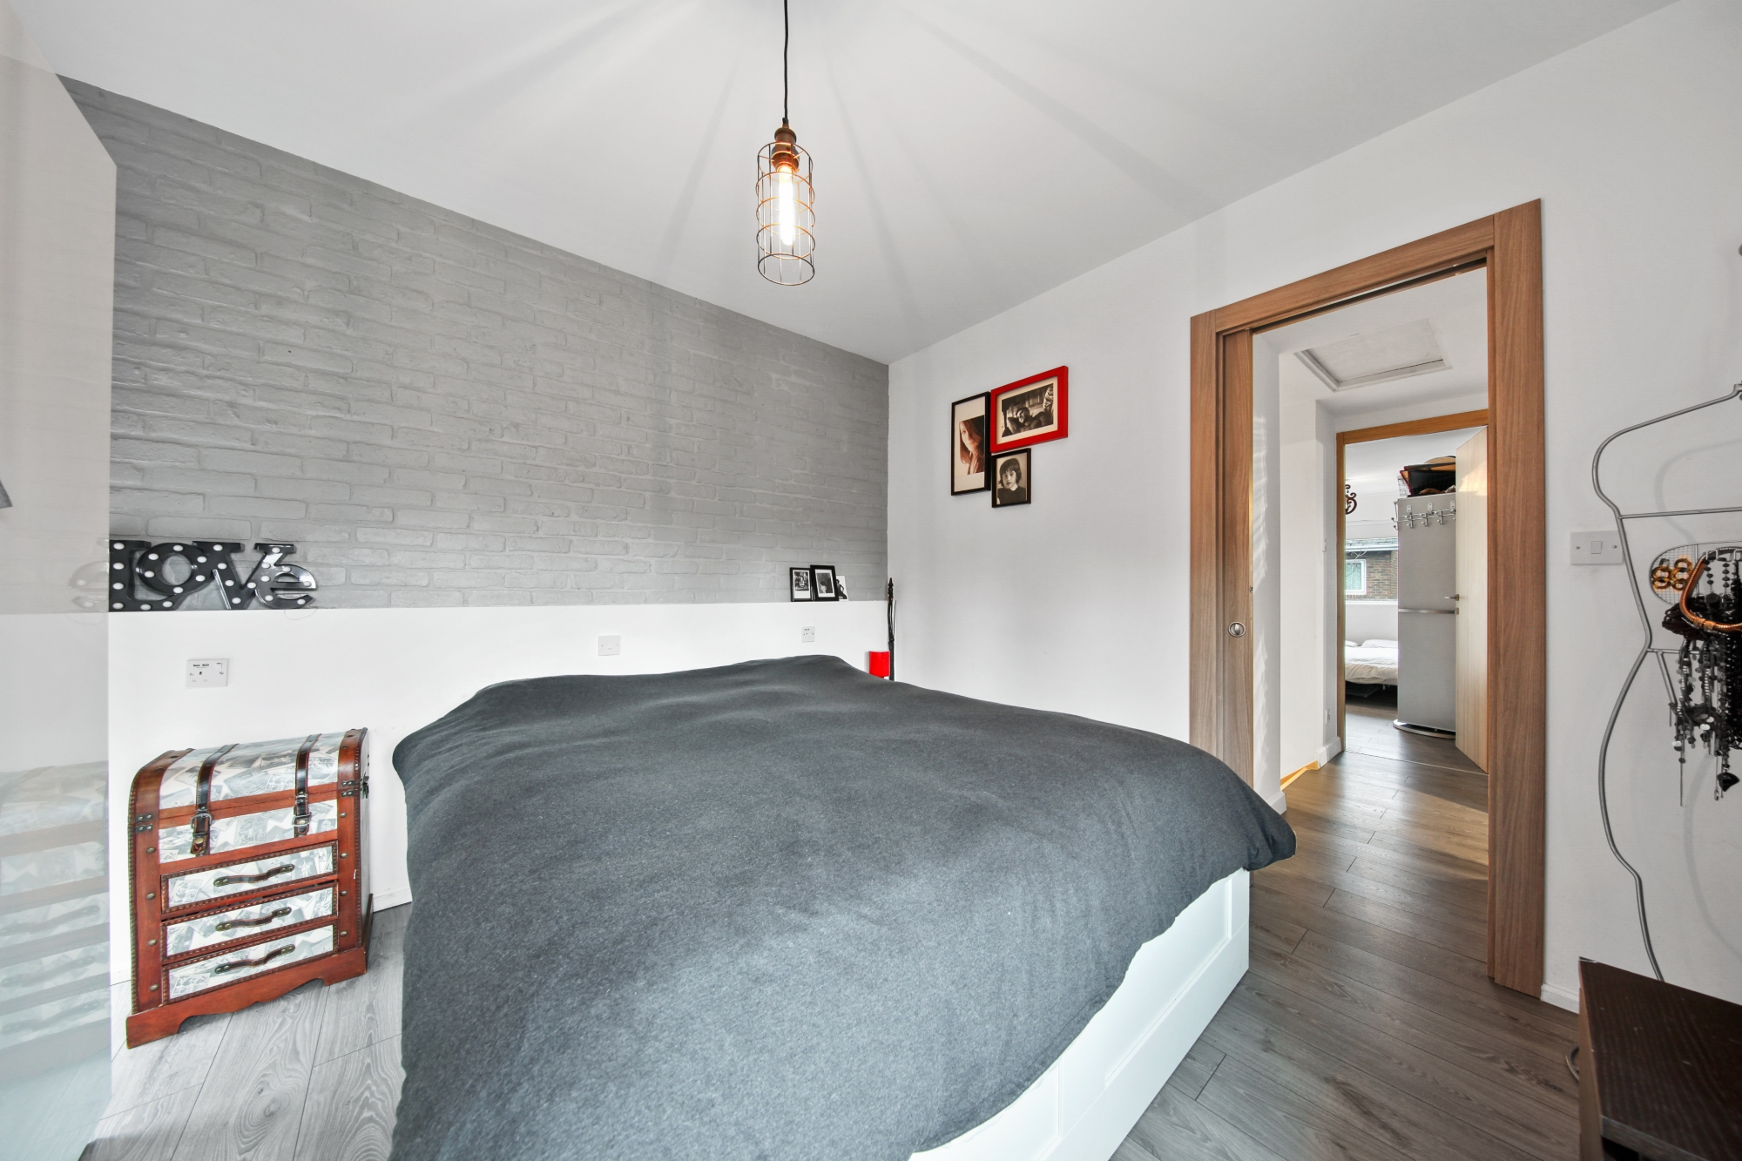
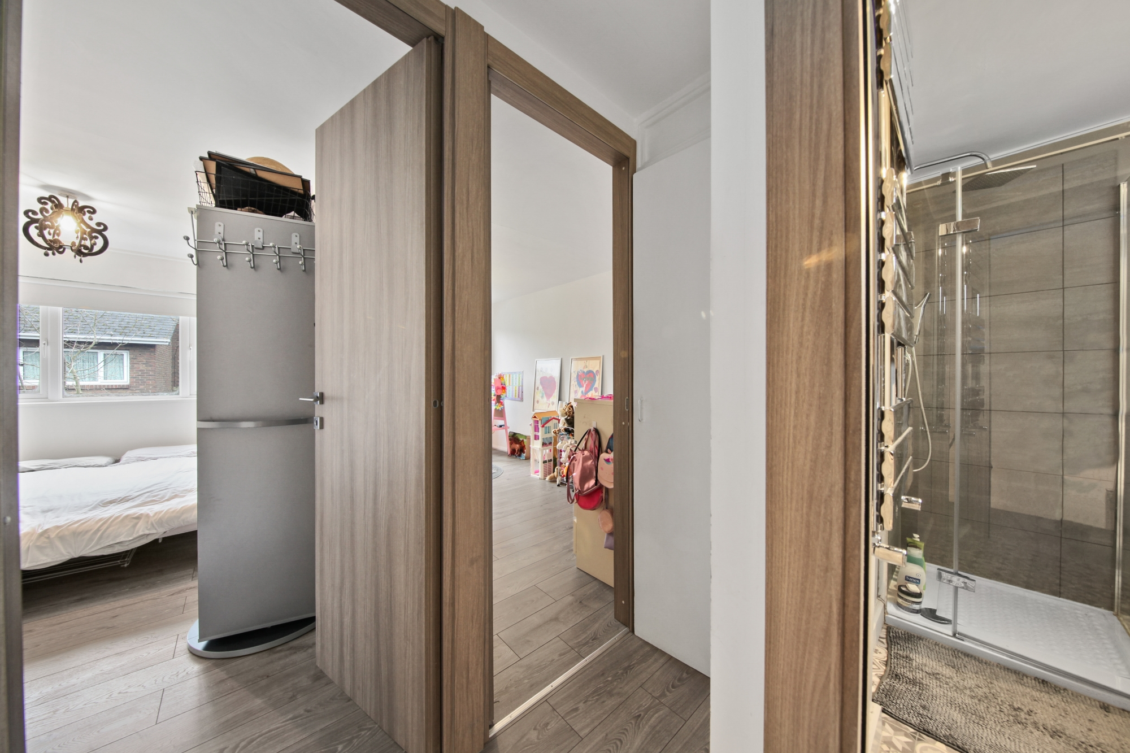
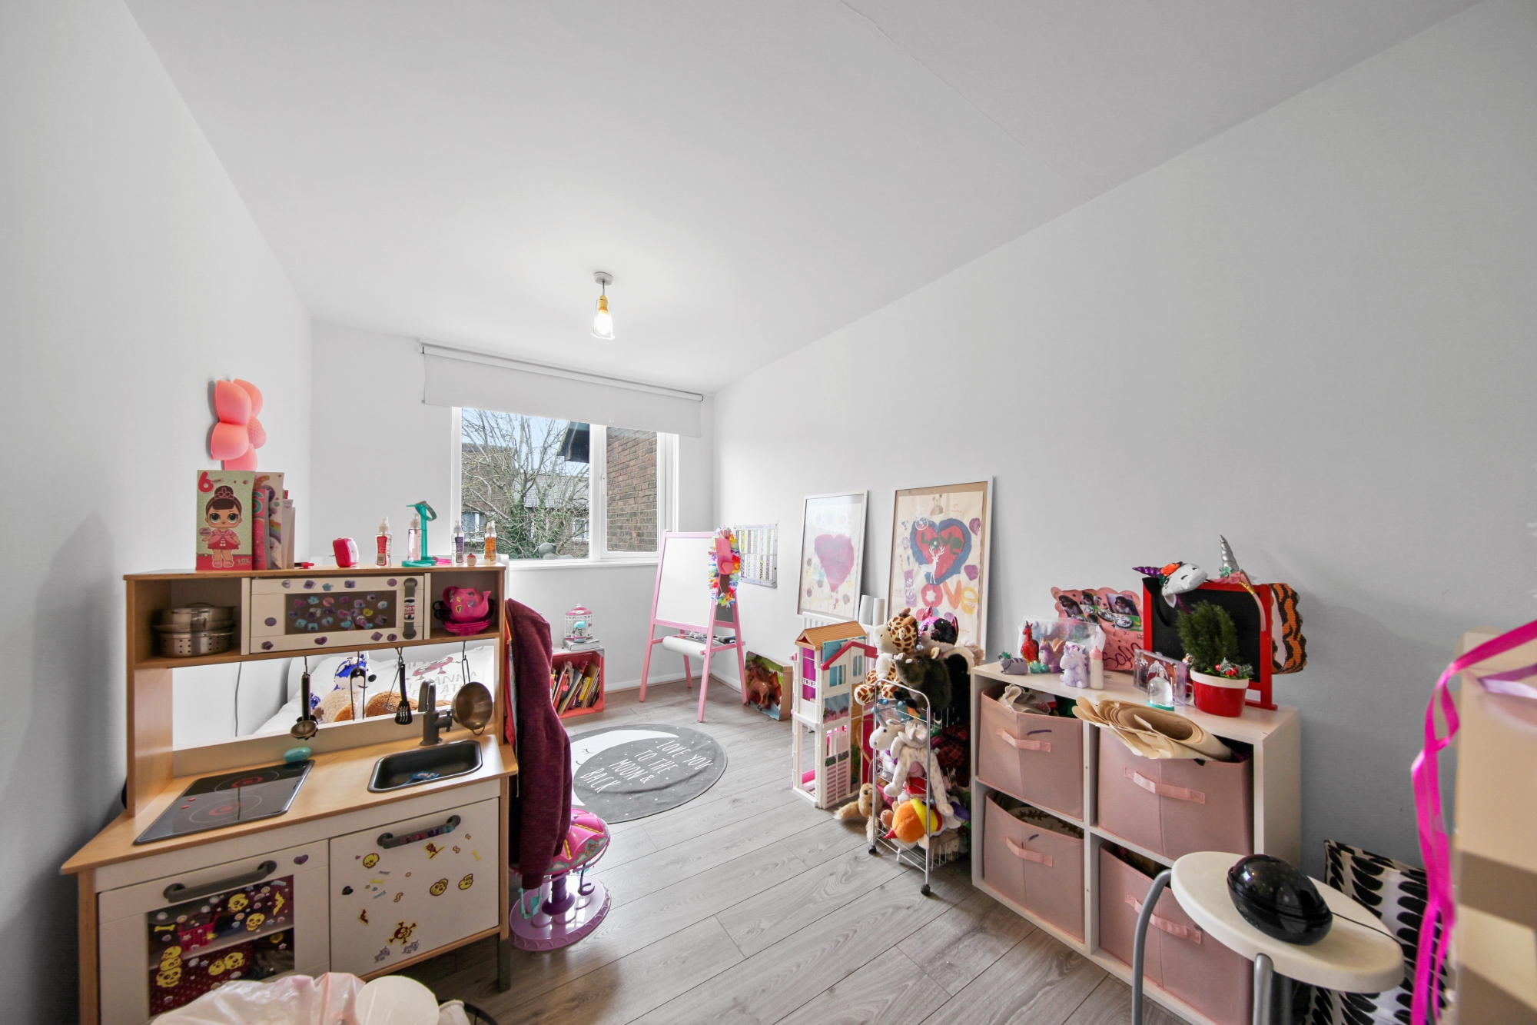
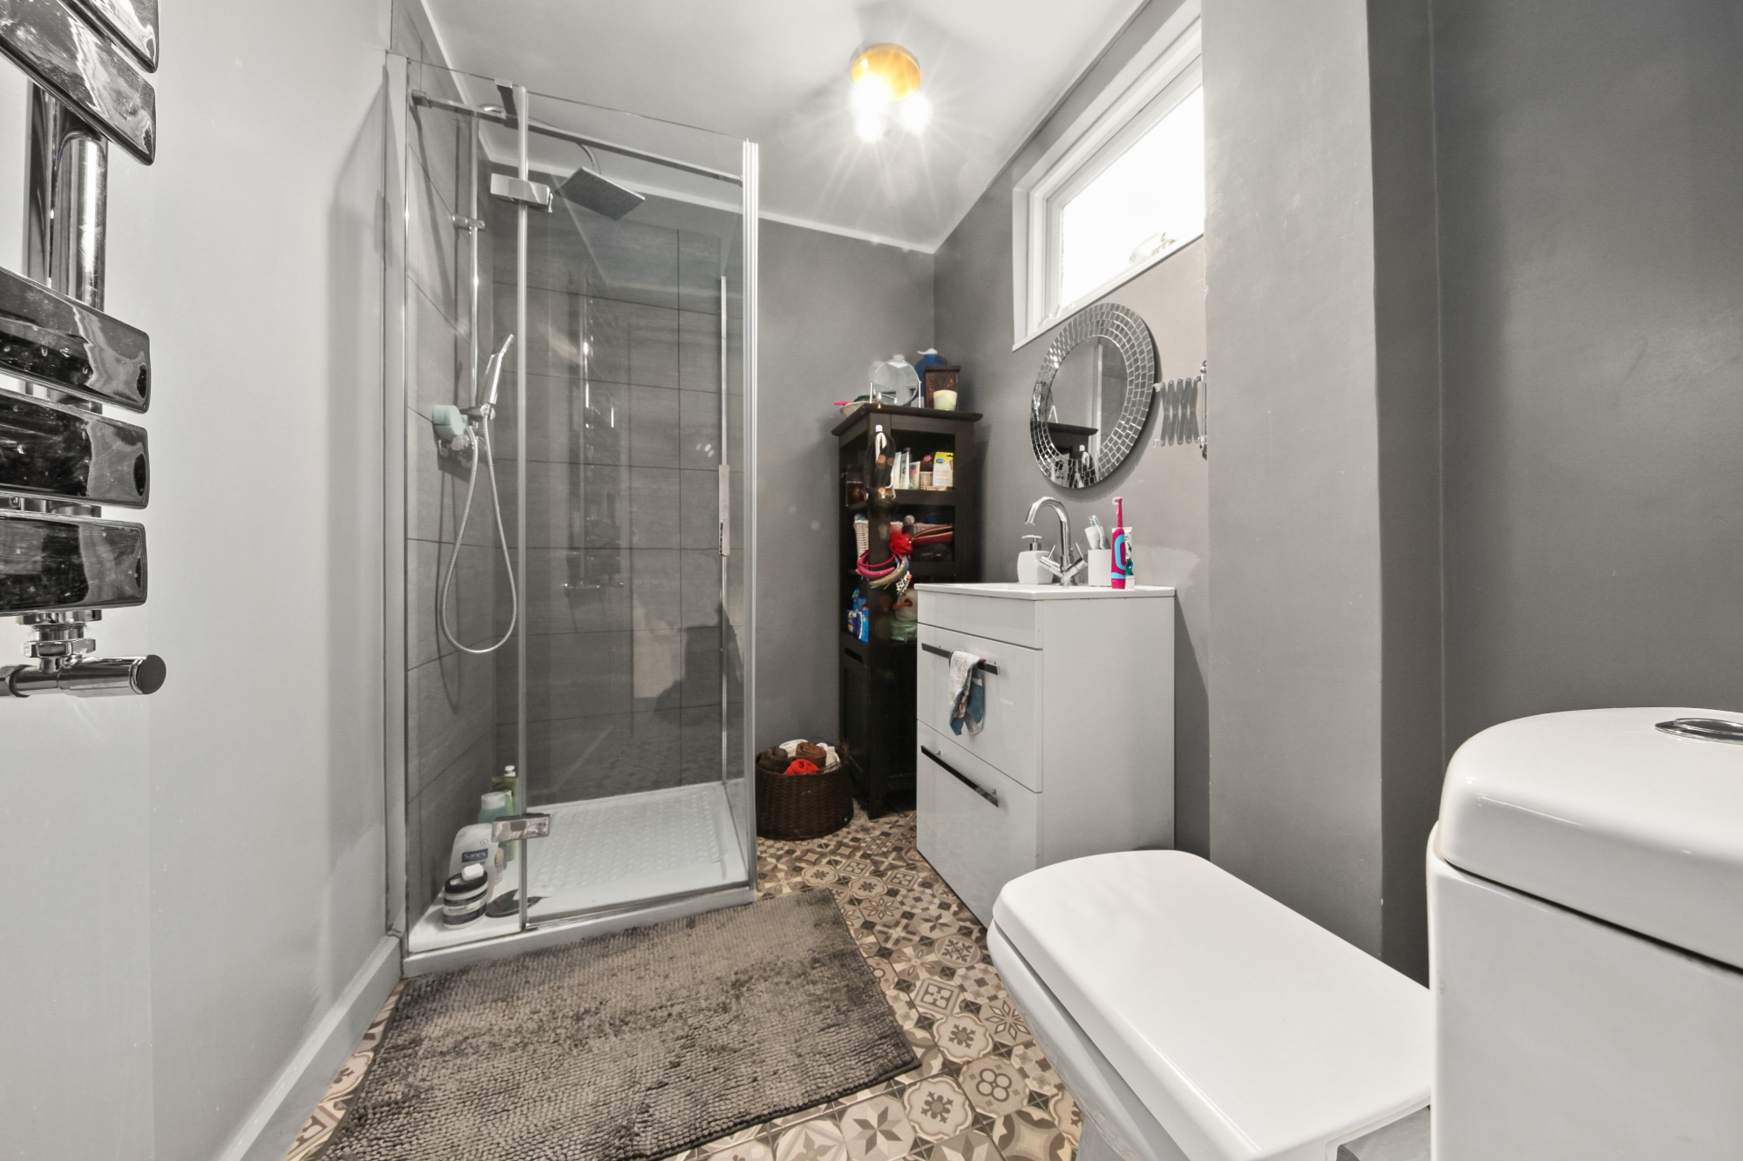
07460 088 110
Trusted, Expert, Advice

Slide 4
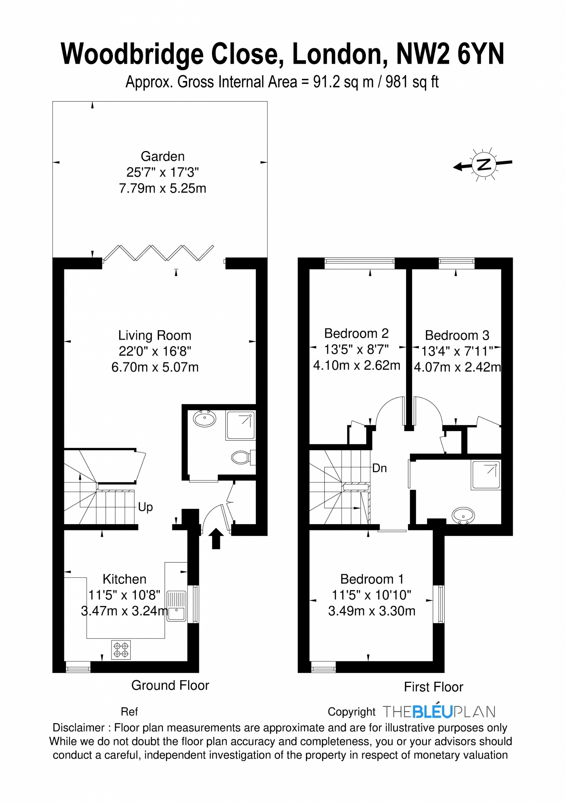
Property Features…
Freehold house
Finished to a high standard
Garden
Close to transport
Walking distance to Gladstone Park
Freehold
Potential for further development
About this location…
Woodbridge close is conveniently located within close walking distance from Gladstone Park with the Gladstone Park Café ideal for a pitstop on a weekend walk, there are tennis courts and two lovely playgrounds. There are numerous schools, Our Lady of Grace Junior School and Menorah girls school to name a few. Local shops are a 5 minute walk and Lidl and the famous Wing Yip are a short drive away.
The Brent Cross regeneration is one of the biggest regeneration projects in Europe and London’s most ambitious regeneration project since the start of the pandemic - it will become the capital’s biggest “15 minute town” where shops, offices, restaurants, parks and the train station are all within a quarter of an hour’s walk.
Transport – It is equidistant from Dollis Hill and Neasden Underground stations and within easy reach of Staples Corner, Brent Cross and the M1. Cricklewood Overground is on the Midland Main Line, with regular services to London St Pancras, Wimbledon, Sutton, Luton and St Albans. The station is also served by a number of London bus routes leading all over the city.
Trusted, Expert, Advice

